Slide 1
Enron network analysis and community DETECTION
SUBMITTED BY: KAUSTUBH LOHANI
CWID: 20012217

Slide 2
Agenda
Introduction
Problem Statement
Dataset Statistics
Data Cleaning and Preprocessing – The need
Data Cleaning and Preprocessing
Graph Exploratory Analysis
Community Detection
Louvain Algorithm
Label Propogation Algorithm
Lieden Algorithm
Infomap Algorithm
Walktrap Algorithm
Markov Clustering Algorithm
Girvan-Newman Algorithm (Level 7 to Level 20)

Slide 3

Introduction
The Enron email communication network offers a case study for understanding complex organizational structures through the lens of social network analysis.
This project focuses on the detection of communities within the Enron email dataset, which encapsulates interactions among over a thirty-six thousand unique emails
Originally disclosed by the Federal Energy Regulatory Commission during its investigation.

Slide 4
PROBLEM STATEMENT
“Identify communities in the email-Enron dataset.”

Slide 5
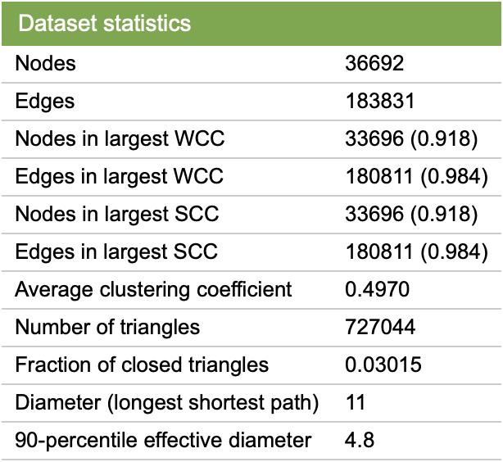
DATASET STATISTICS
Average degree of the original network: 10.02
Additional Important Data Description
Note that non-Enron email addresses act as sinks and sources in the network as we only observe their communication with the Enron email addresses.

Slide 6
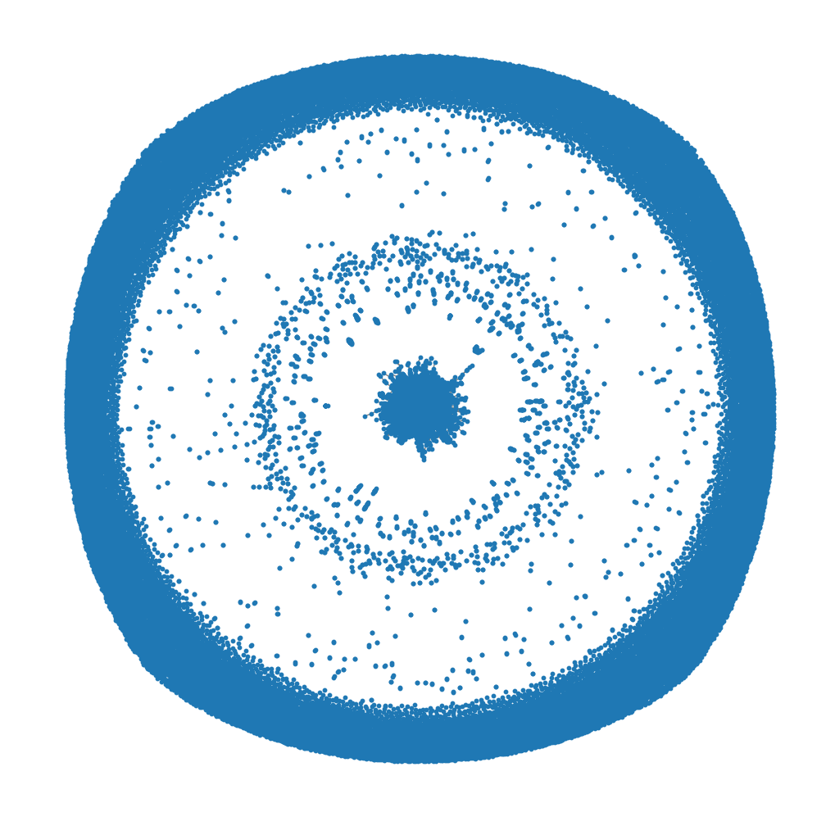
DATA CLEANING AND PREPROCESSING – The need
Visualization without cleaning
This visualization is printed by random edge sparsification i.e. randomly removing 95% of the edges.
Here we can see the sources and sinks (non-enron emails) as described in the data description.
These emails as highlighted in data description are of no use for gaining insights about the communities of Enron.

Slide 7
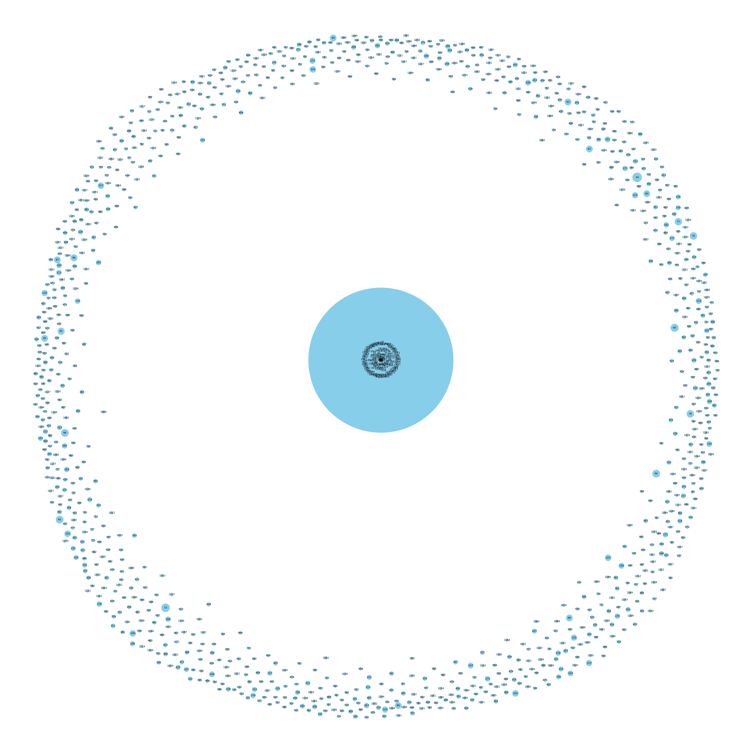
DATA CLEANING AND PREPROCESSING - THE need - II
Here, the blue circles are the nodes.
The size of the blue circles represents the size of the community.
Here we can see that the center community is the biggest and all the rest of them are represented with small circles.
It can be inferred that the center community is the actual representation of the data and others are just outside Enron emails acting as source and sink.
Therefore, they need to be removed for detecting communities in the meaningful central network.
Community Detection w/o cleaning
(Louvain Algorithm)
Modularity: 0.61

Slide 8

DATA CLEANING AND PREPROCESSING - II
Removing Non-Enron Nodes using Statistical analysis
Component Analysis
Filtering small communities
Taking out the largest subsection for community detection
Removing Isolated Nodes
Final graph Statistics:
Number of New nodes: 3459
Number of New edges: 6221
Average degree: 3.6

Slide 9
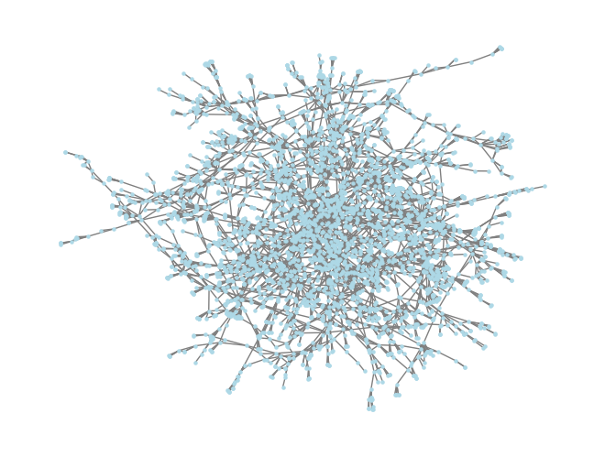
DATA CLEANING AND PREPROCESSING – III
Cleaned Graph Visualization

Slide 10
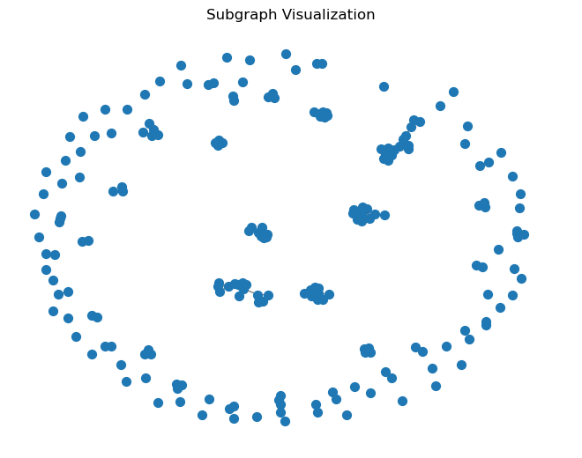
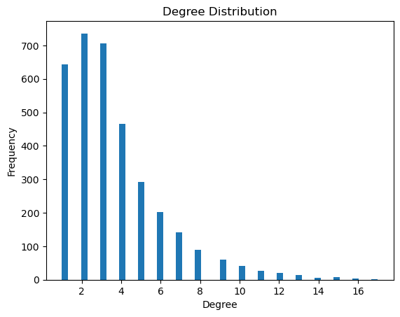
Graph exploratory analysis - I
Average Degree | 3.6
Density of the Graph | 0.001
Average Clustering Coefficient | 0.52

Slide 11
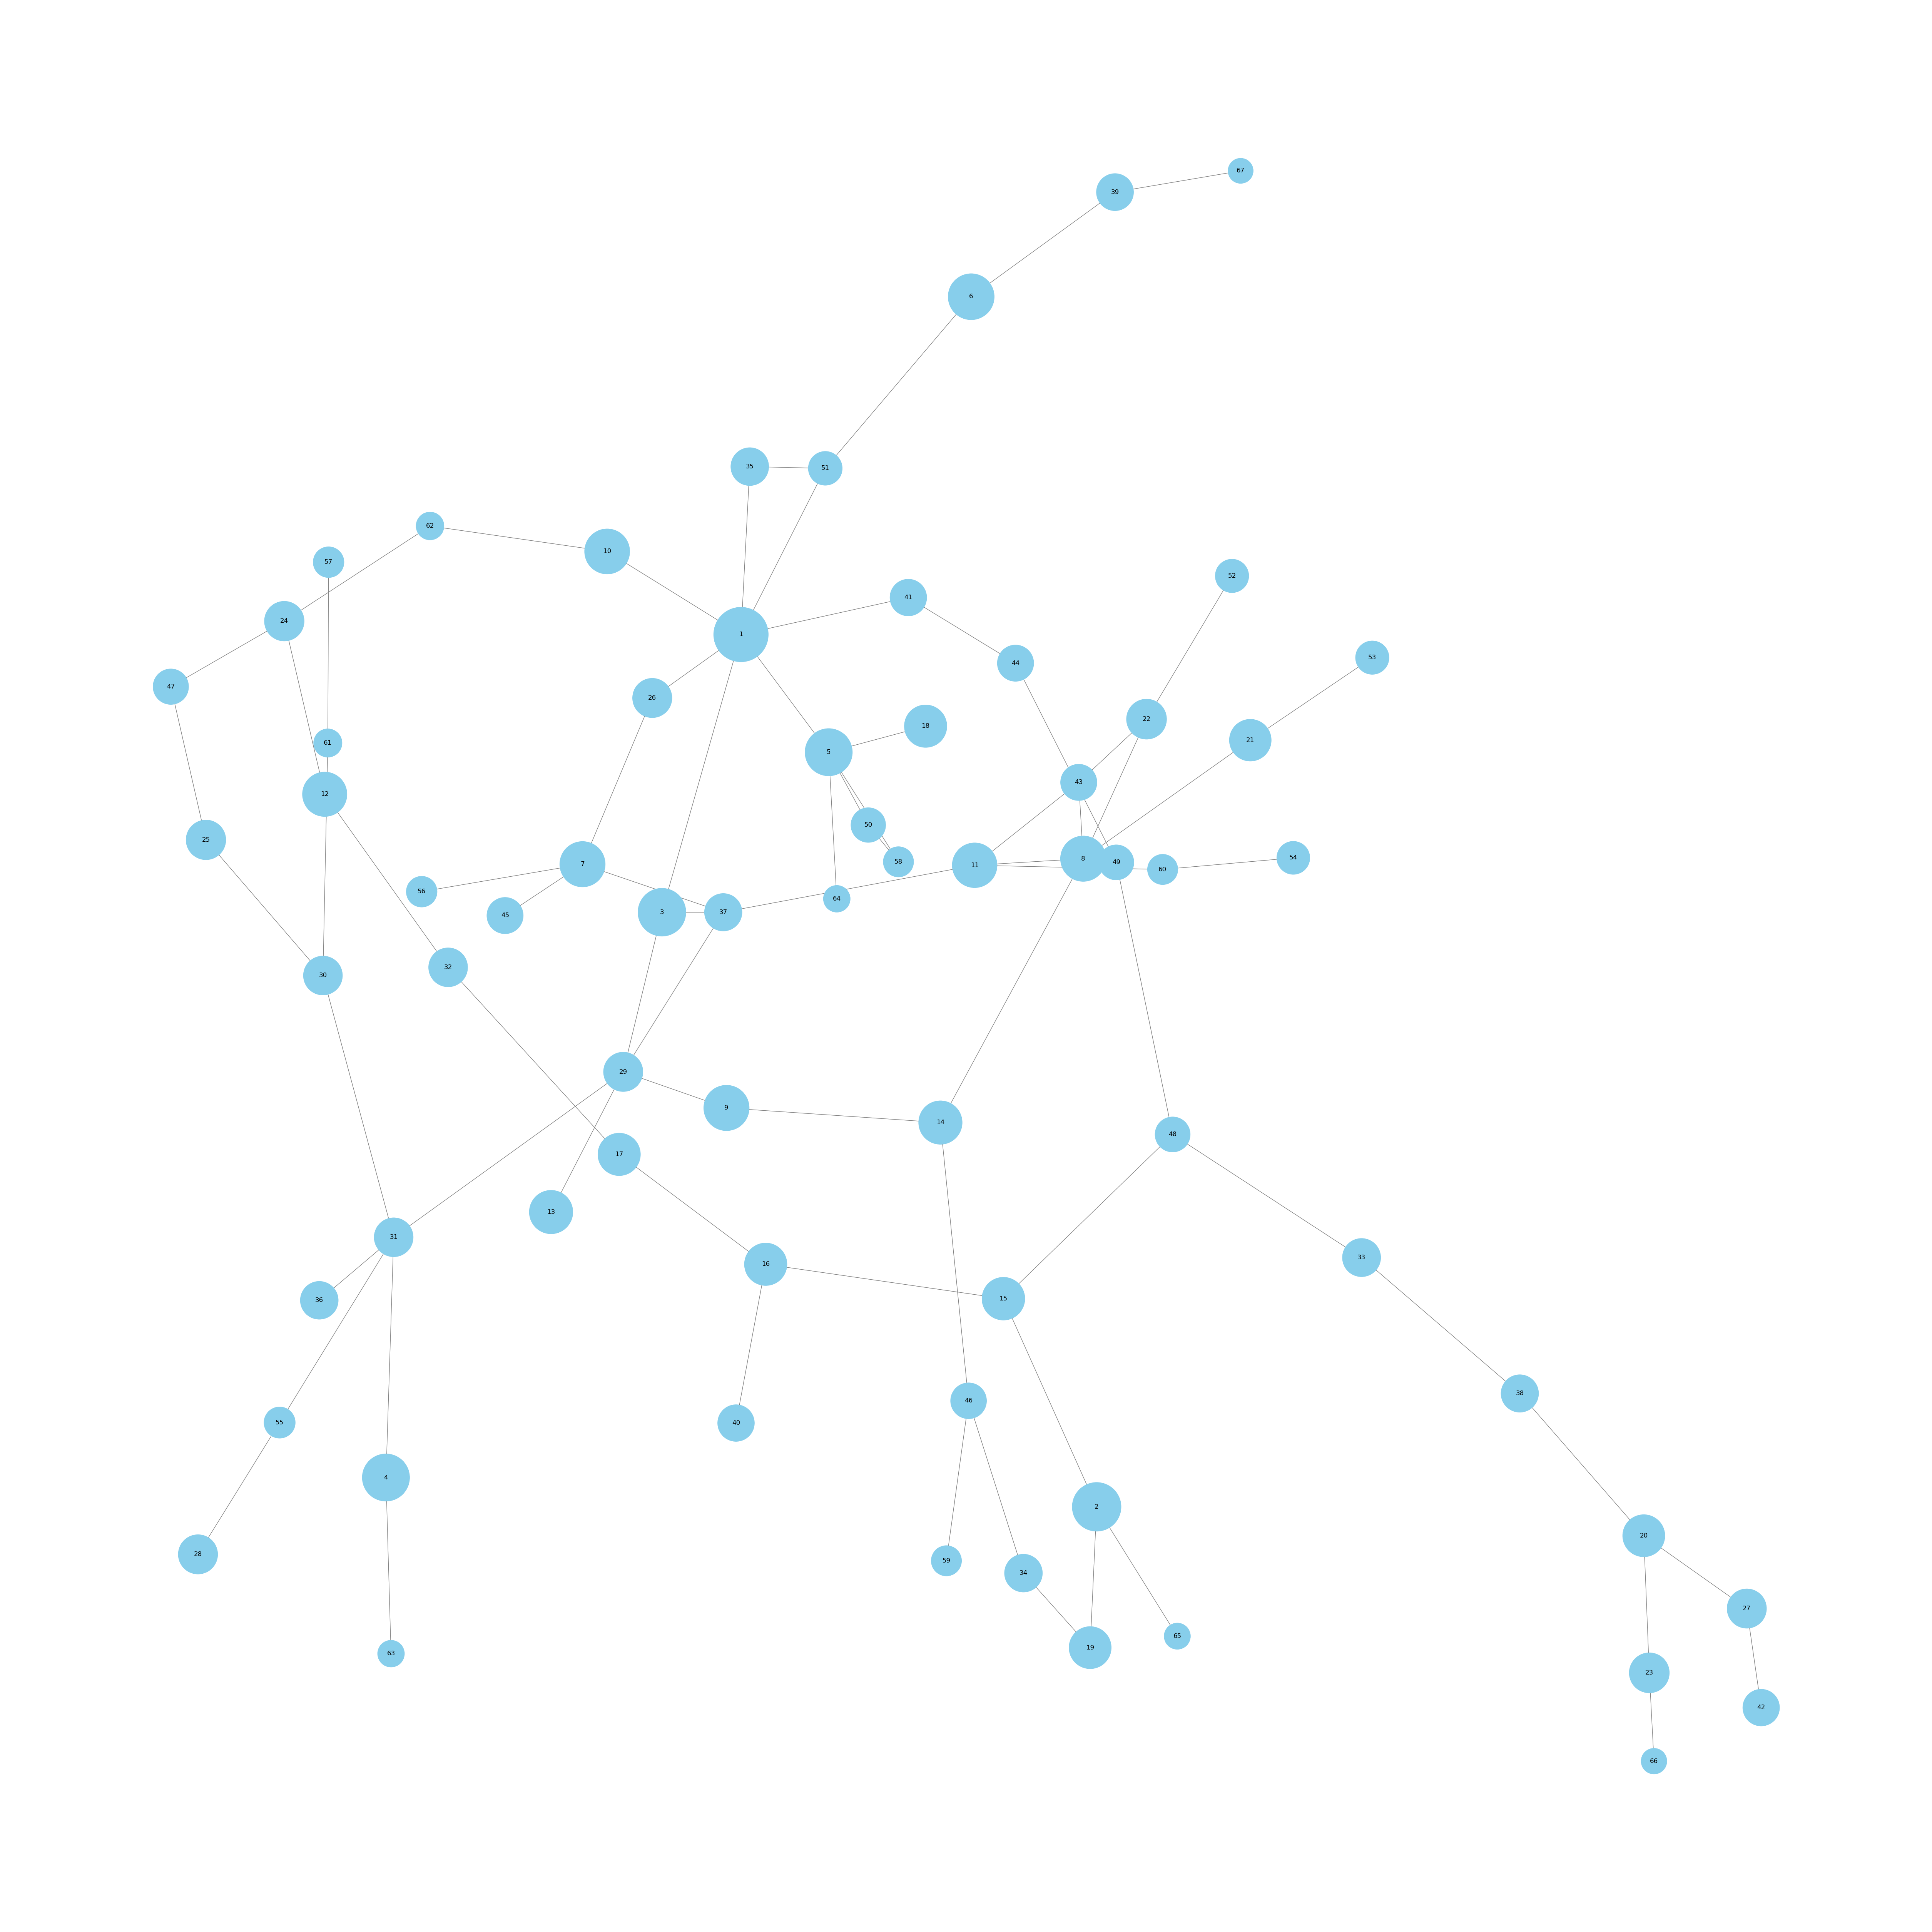
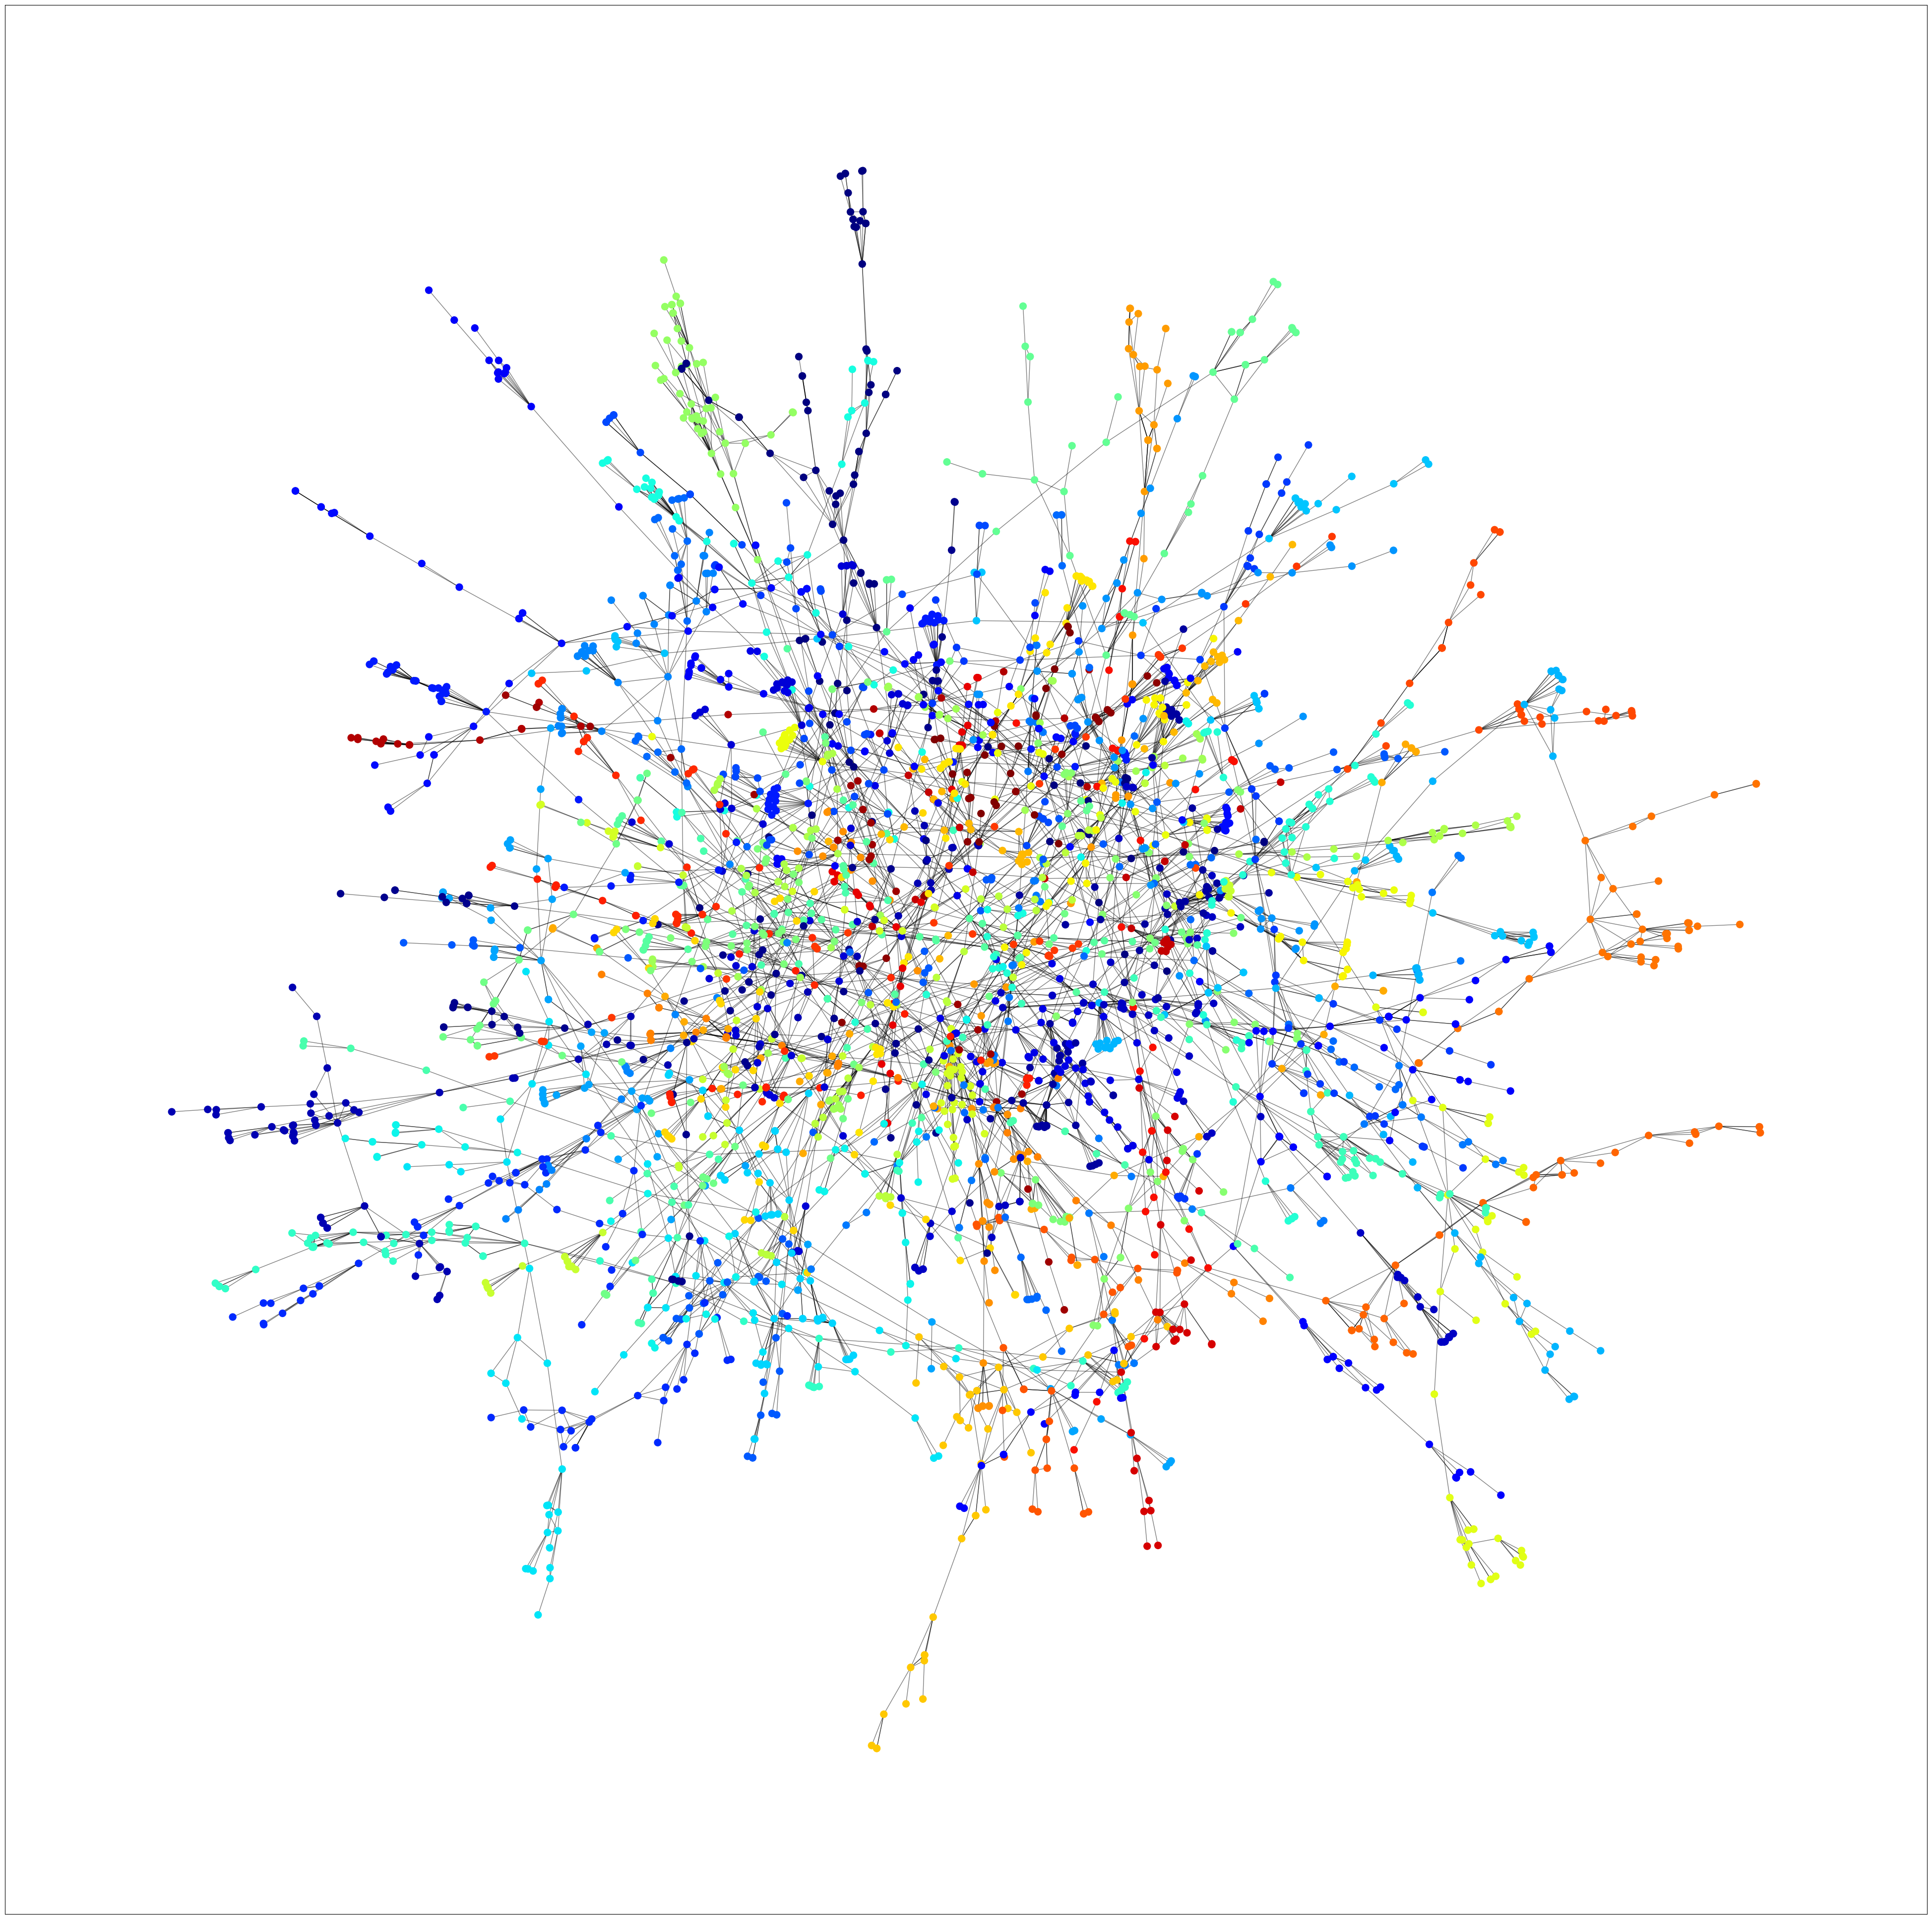
Community detection - Louvain
Condensed Graph
Full Data Graph
Modularity: 0.97
Conductance: 0.015
Number of Communities: 67

Slide 12
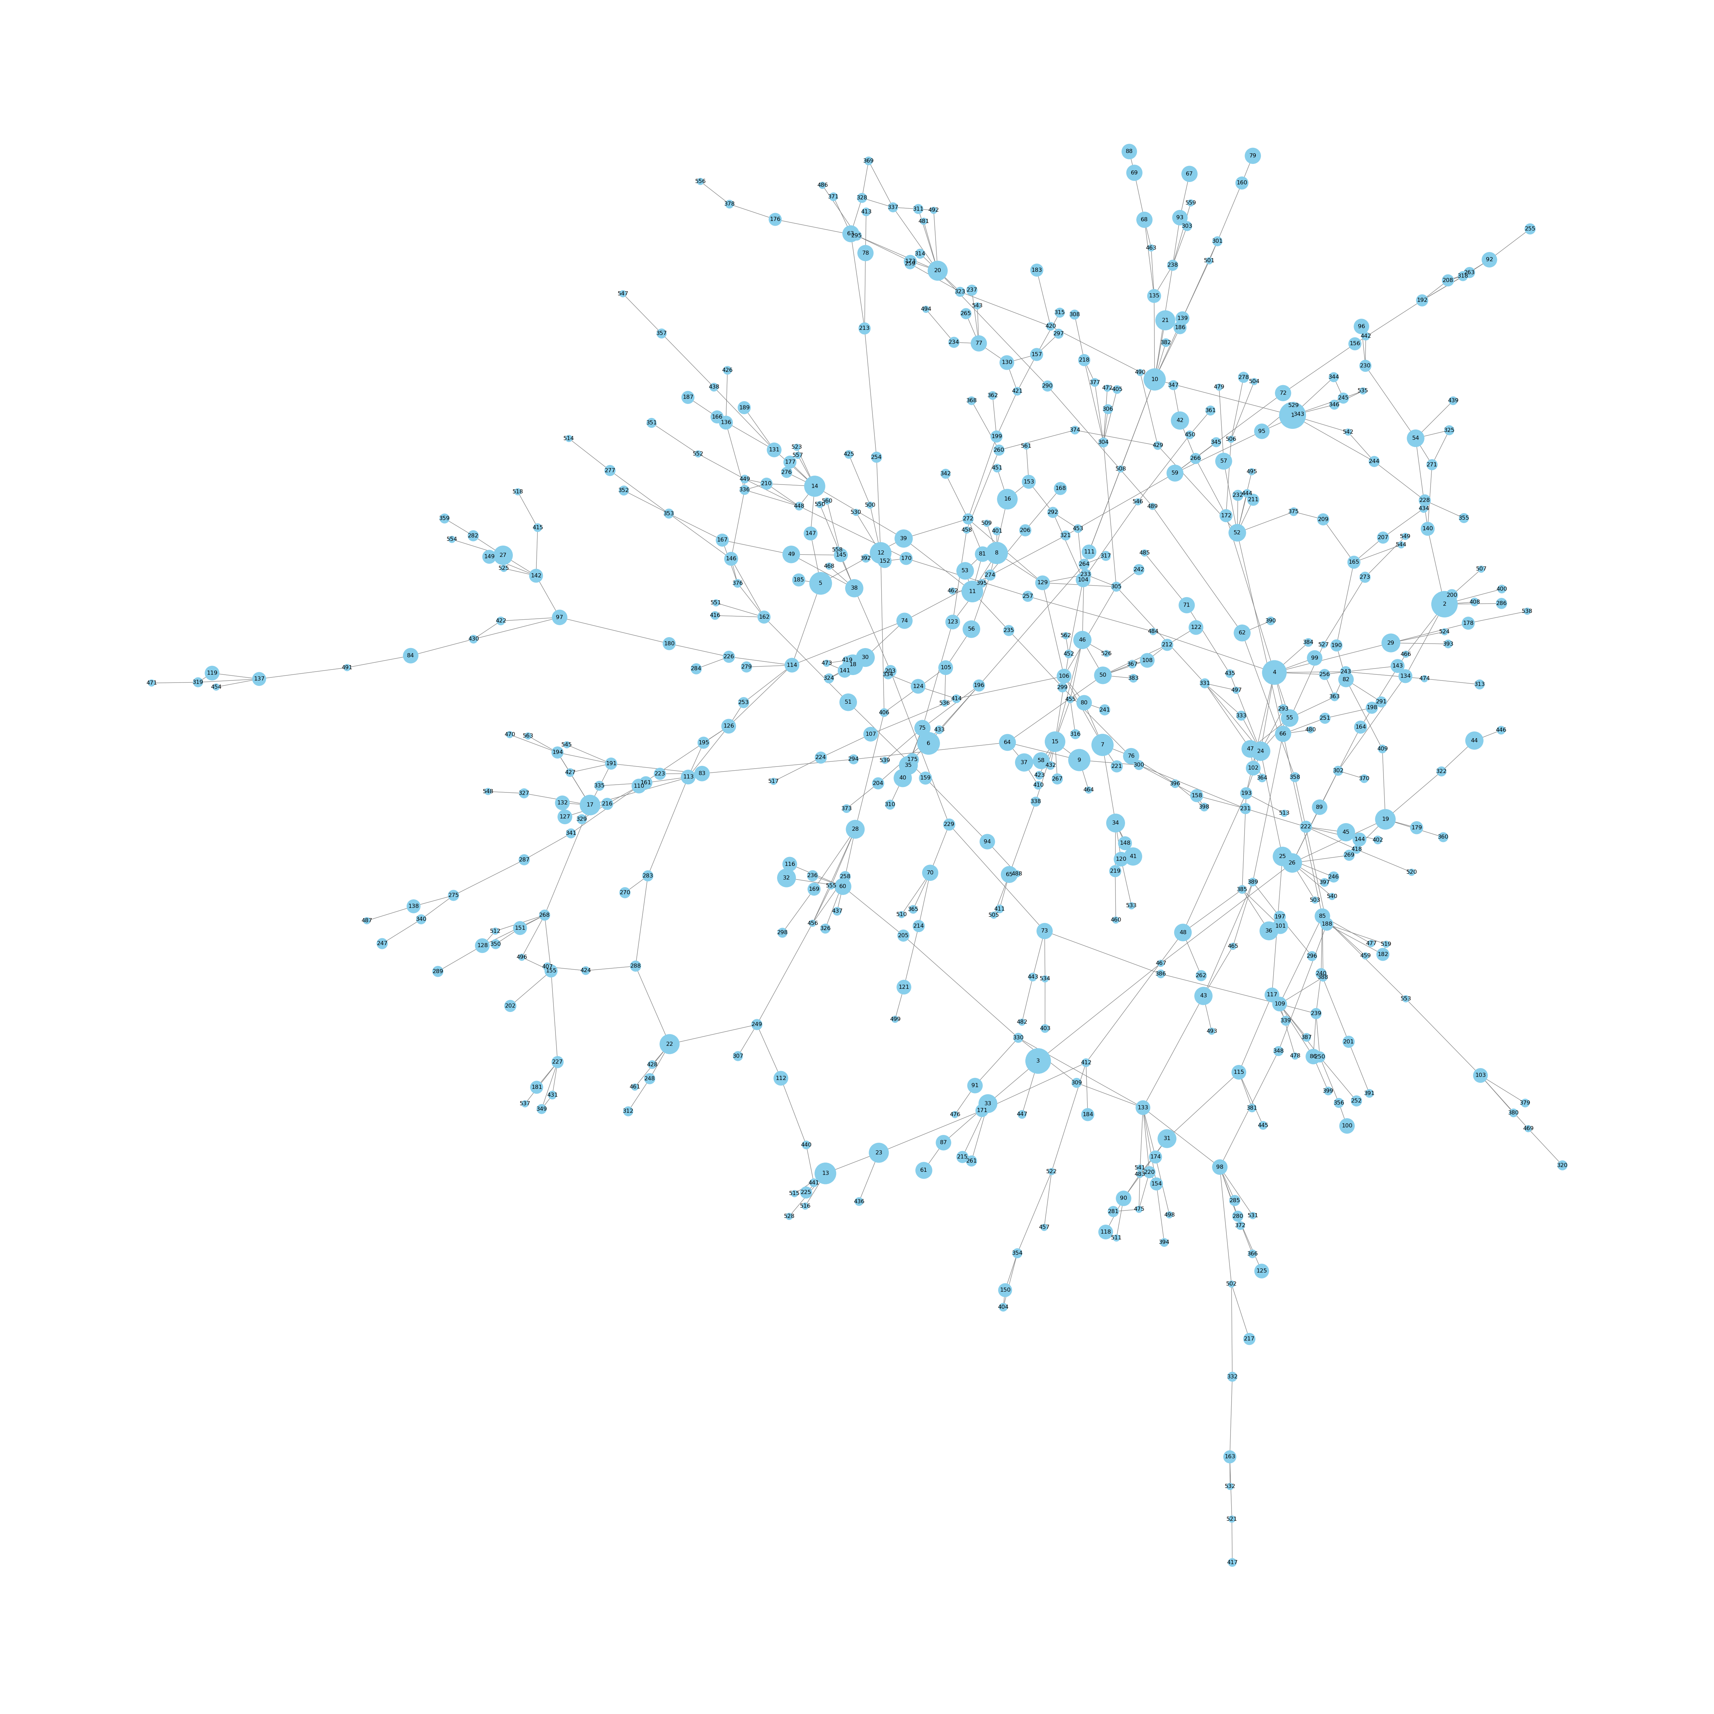
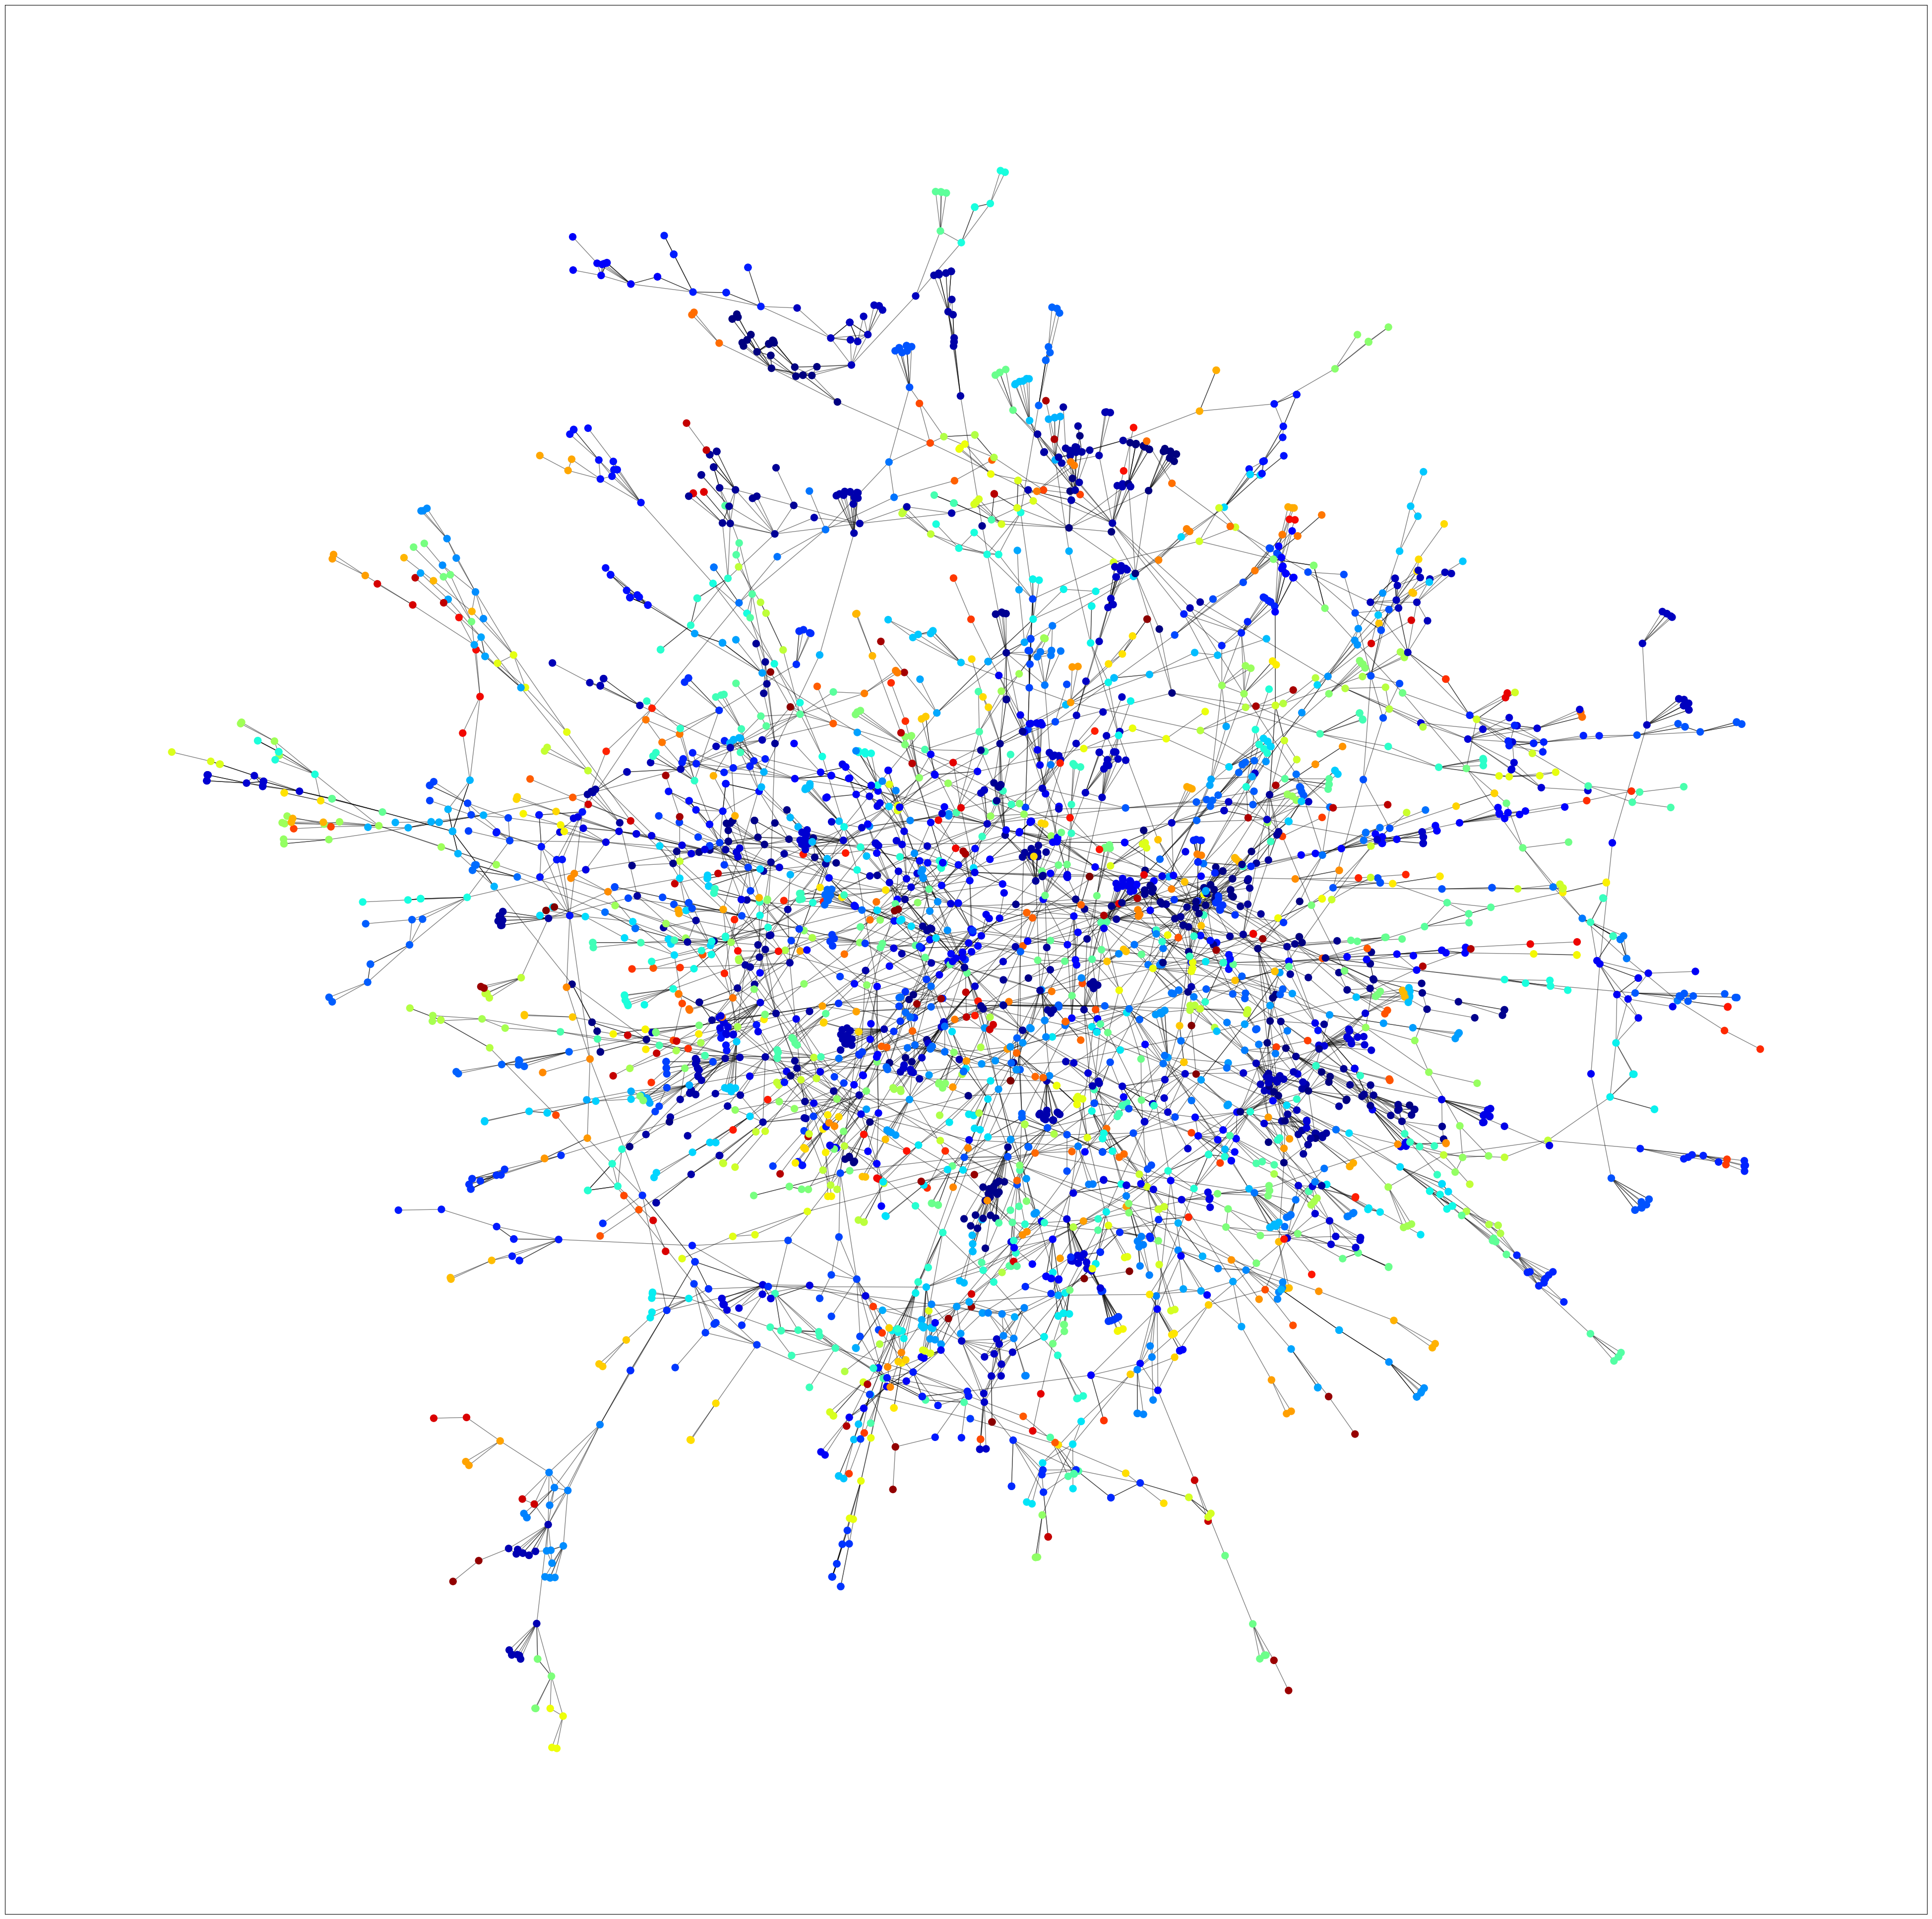
Community detection - LPA
Condensed Graph
Full Data Graph
Modularity: 0.82
Conductance: 0.25
Number of Communities: 563

Slide 13
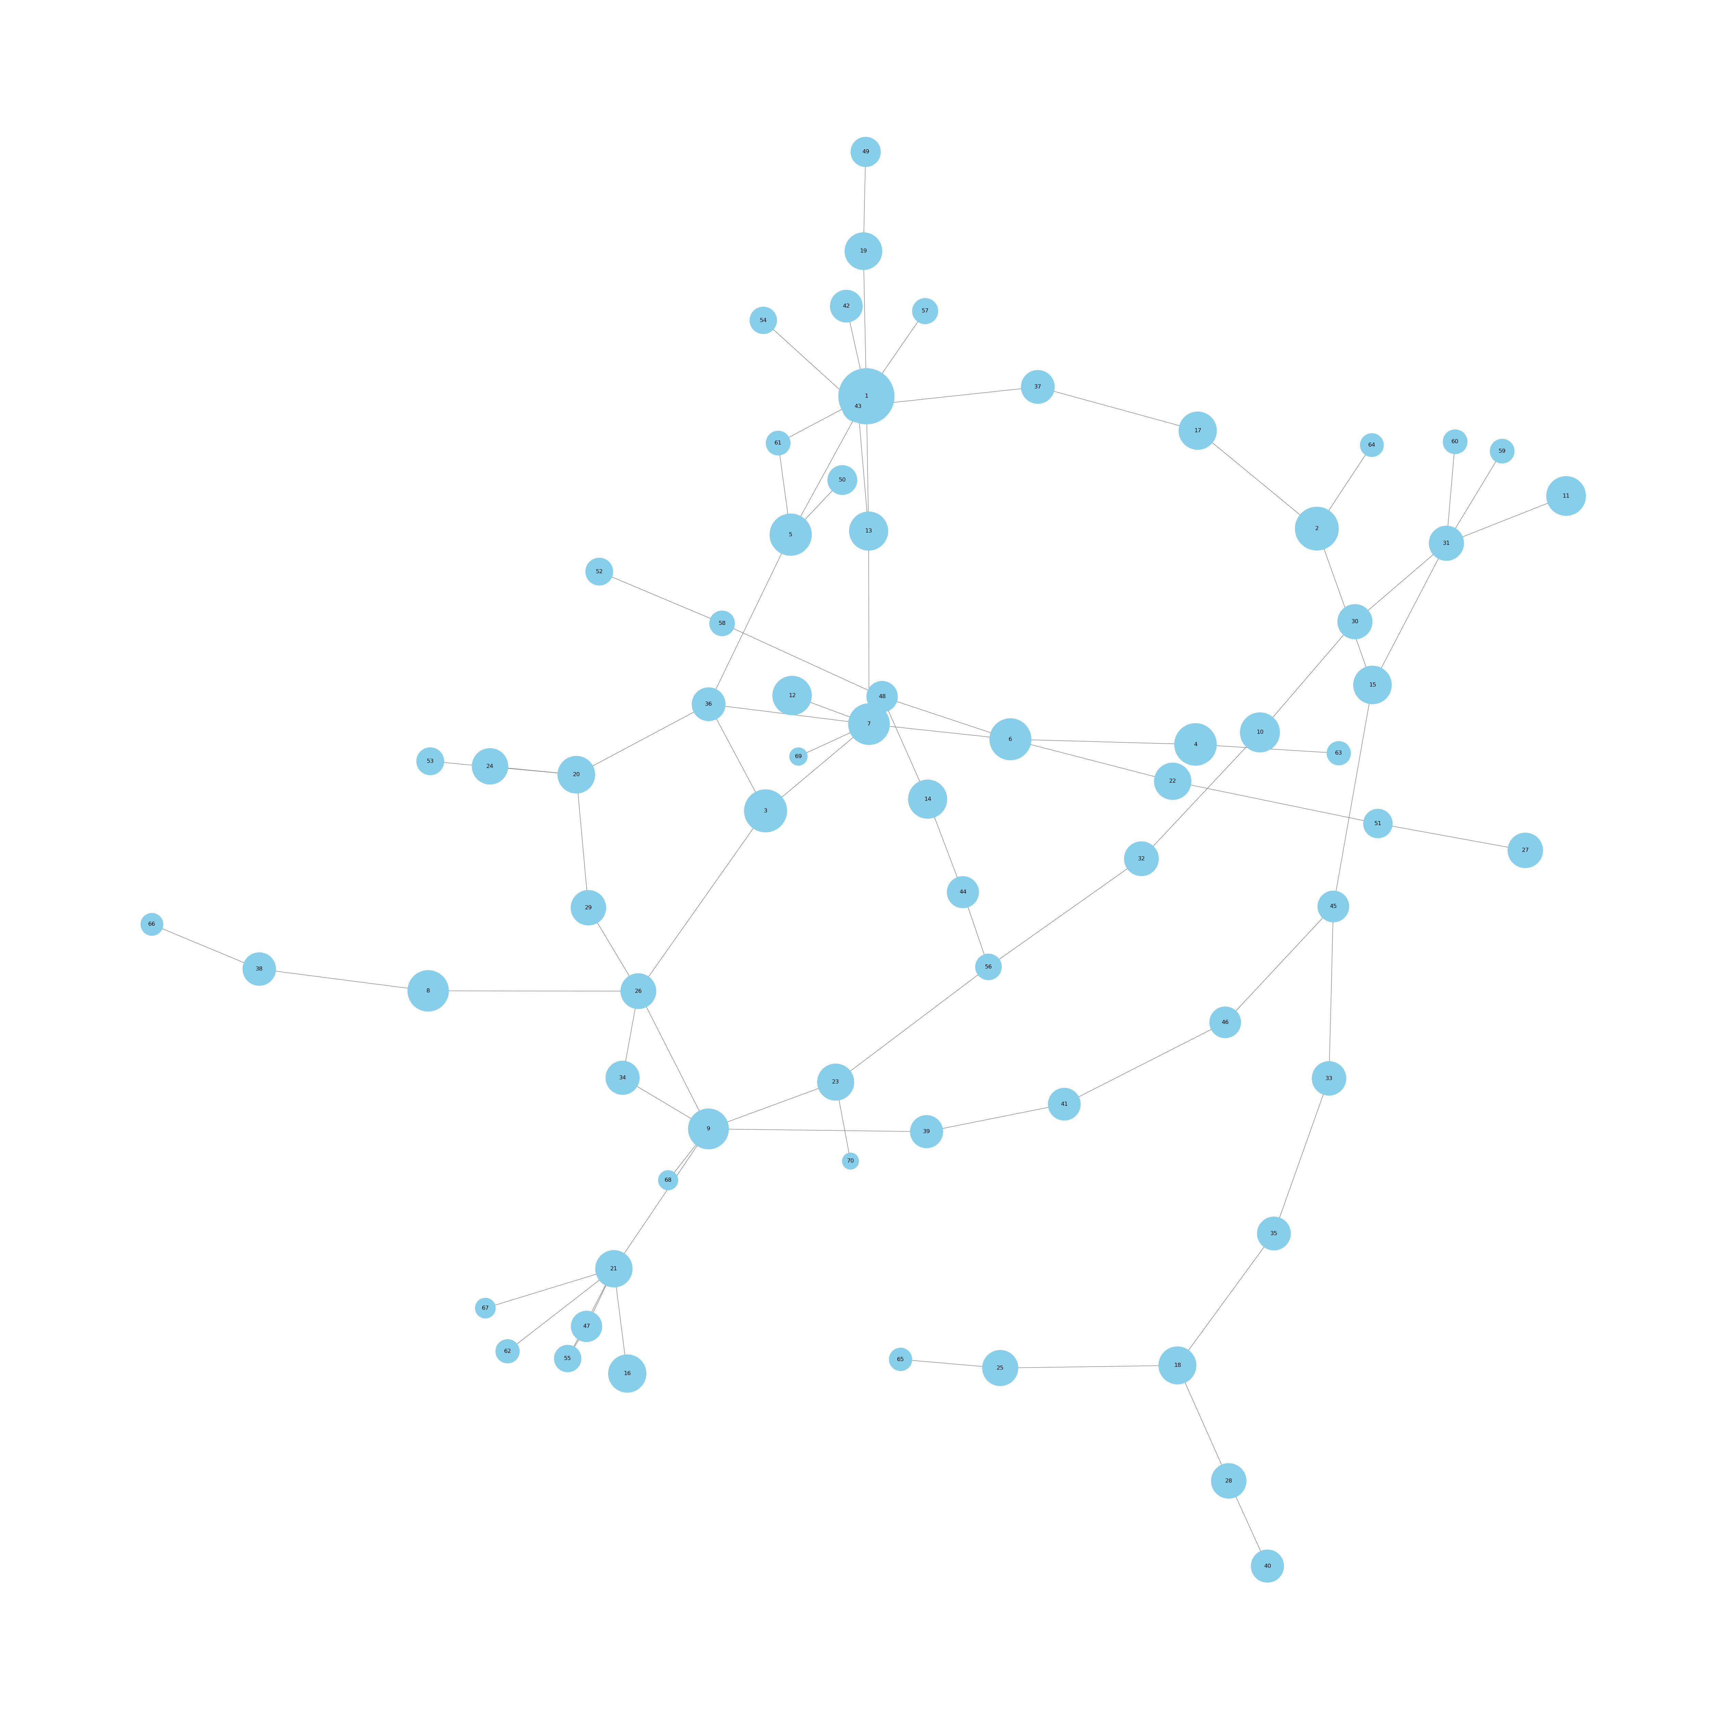
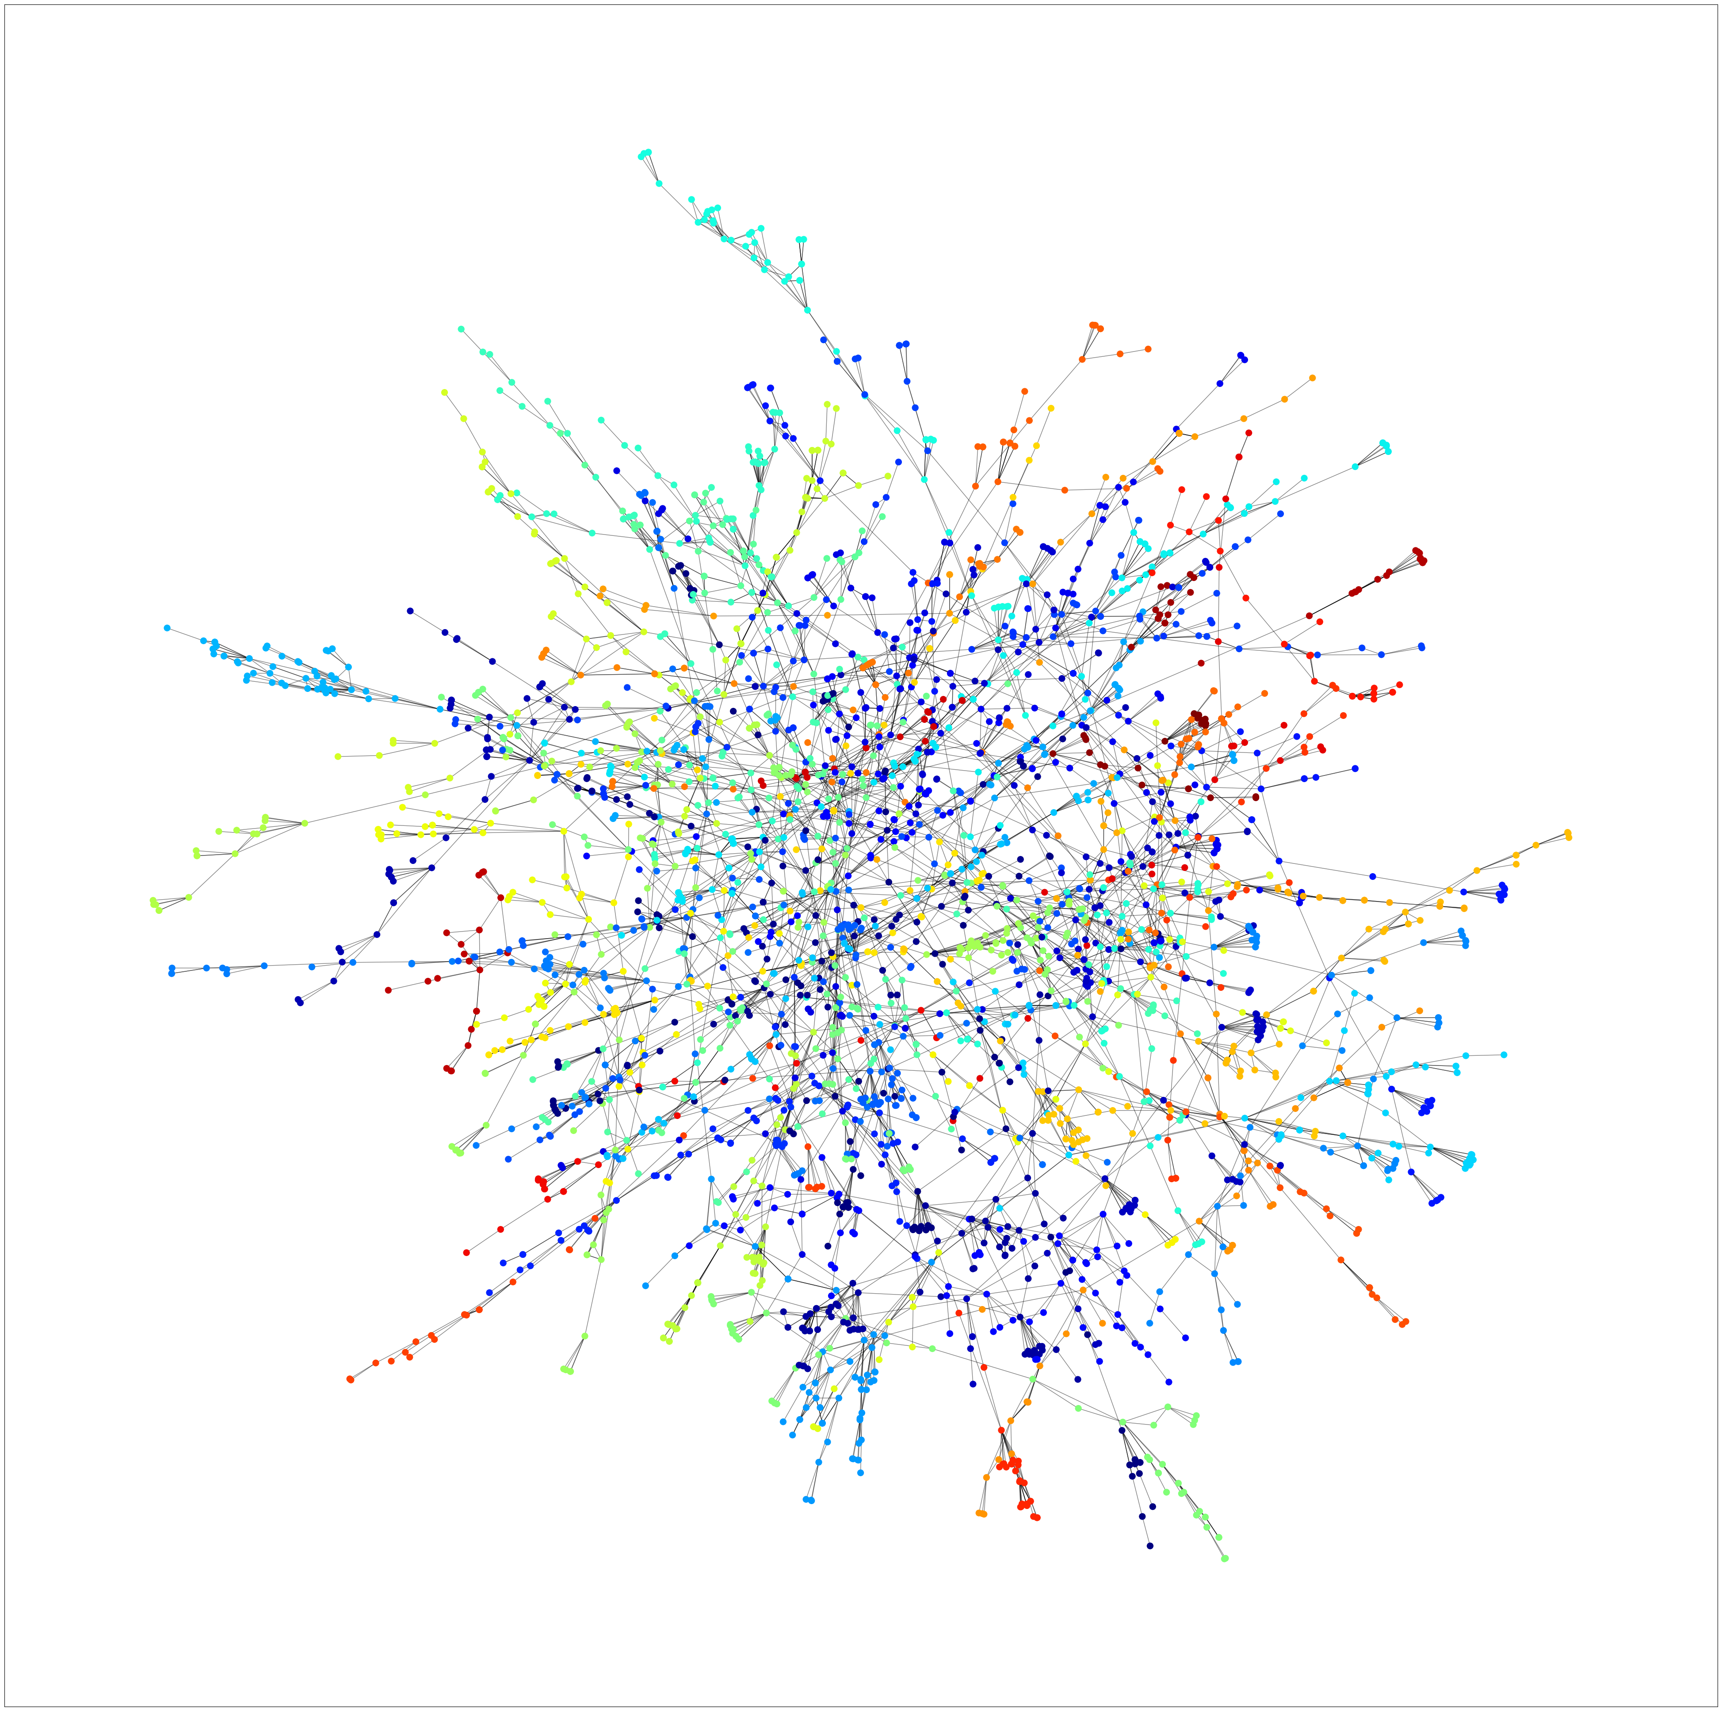
Community detection - Lieden
Condensed Graph
Full Data Graph
Modularity: 0.96
Conductance: 0.151
Number of Communities: 70

Slide 14
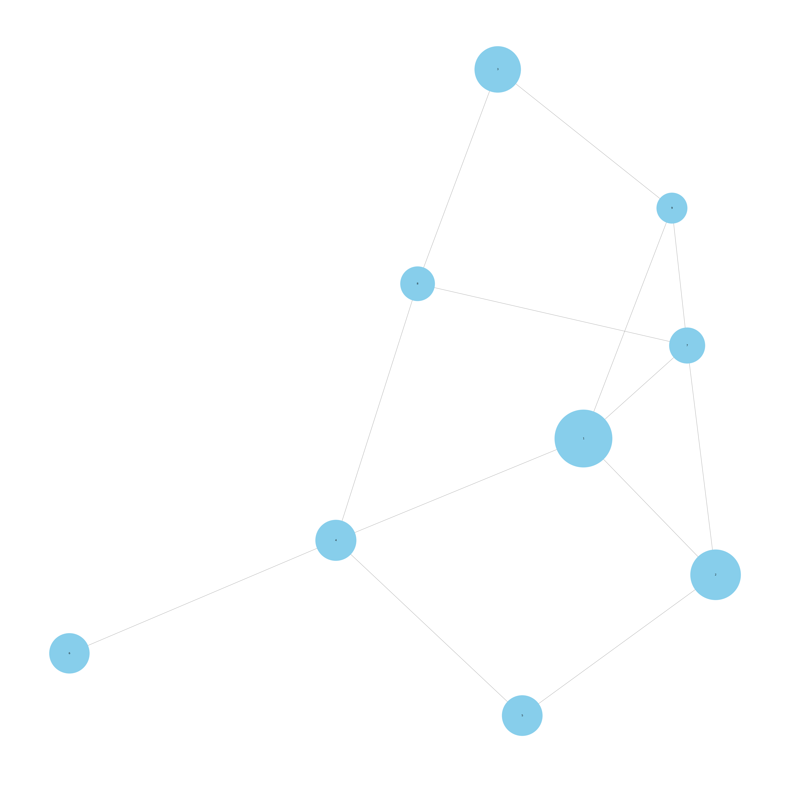
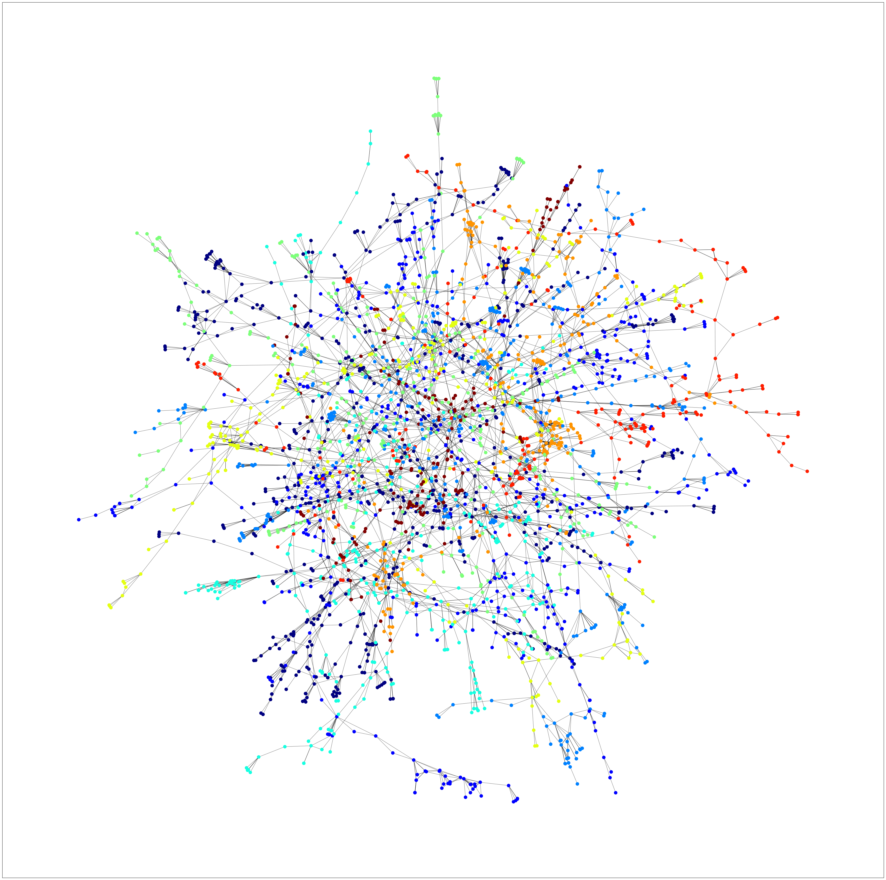
Community detection - infomap
Condensed Graph
Full Data Graph
Modularity: 0.87
Conductance: 0.002
Number of Communities: 9

Slide 15
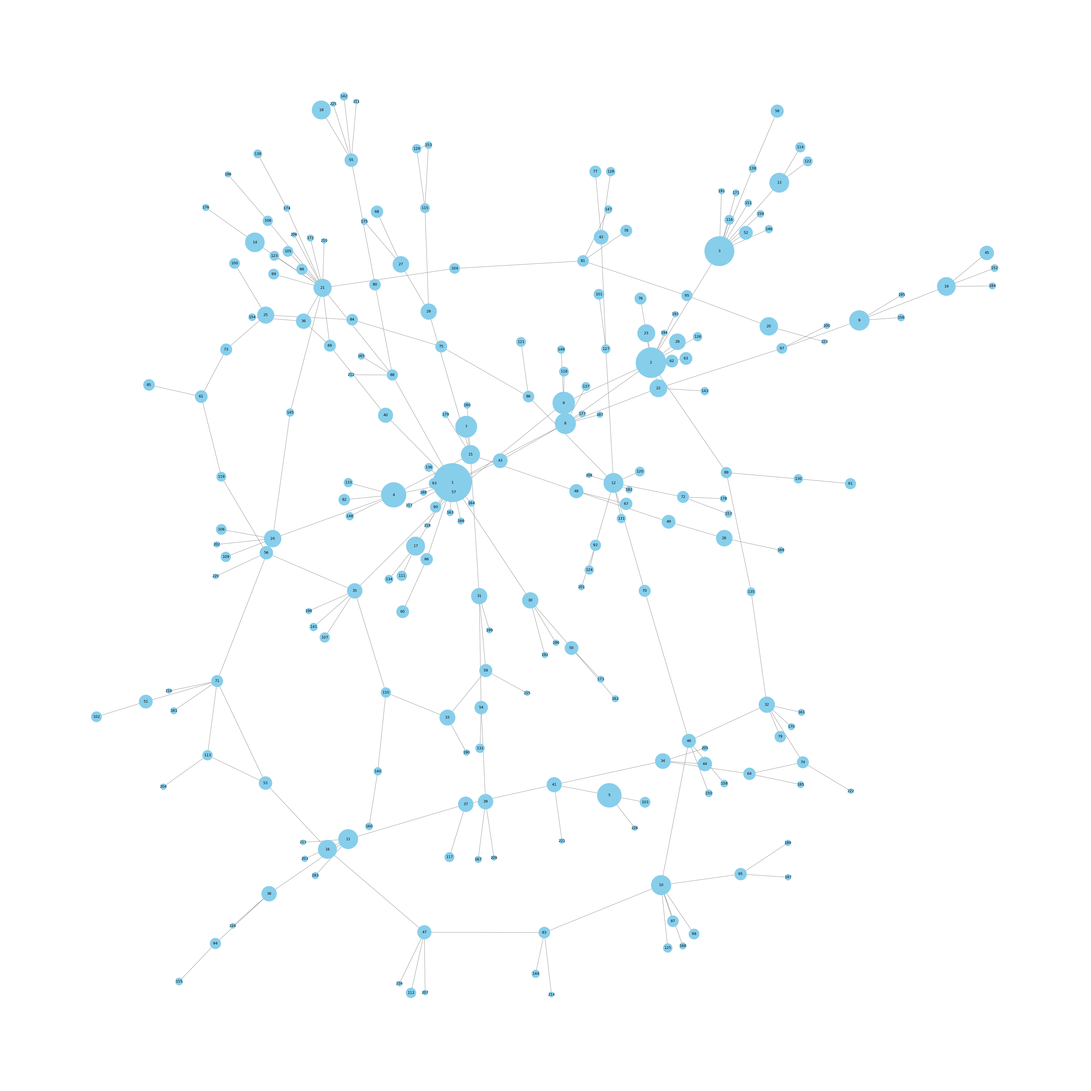
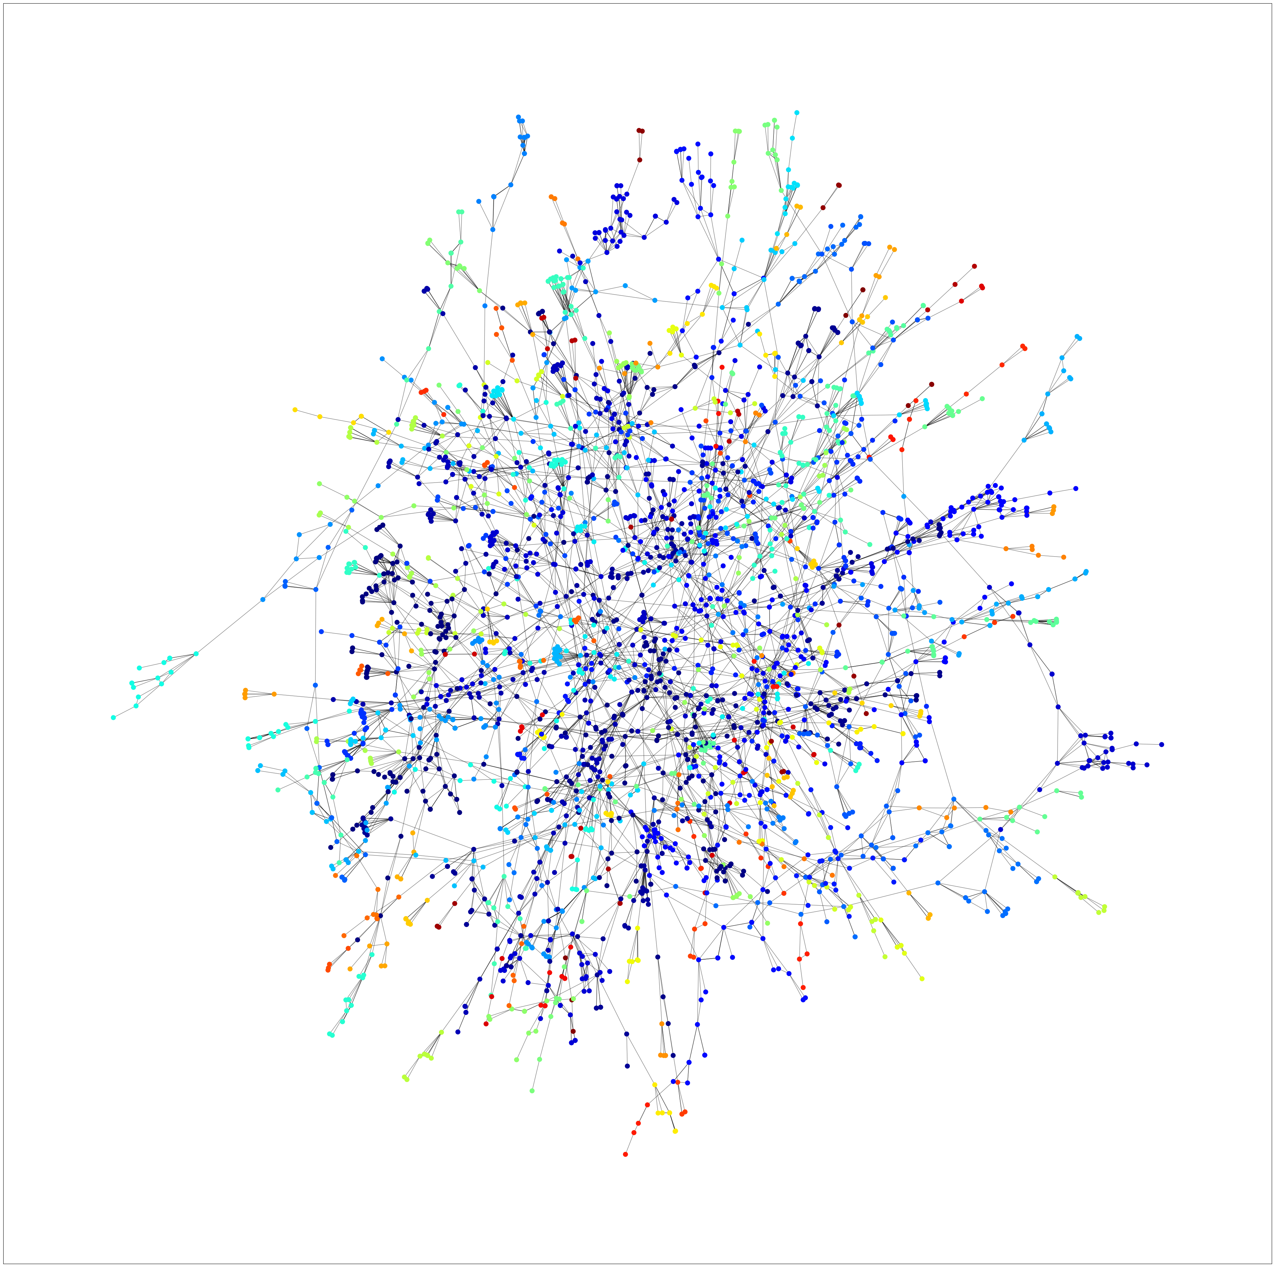
Community detection - walktrap
Condensed Graph
Full Data Graph
Modularity: 0.94
Conductance: 0.08
Number of Communities: 226

Slide 16
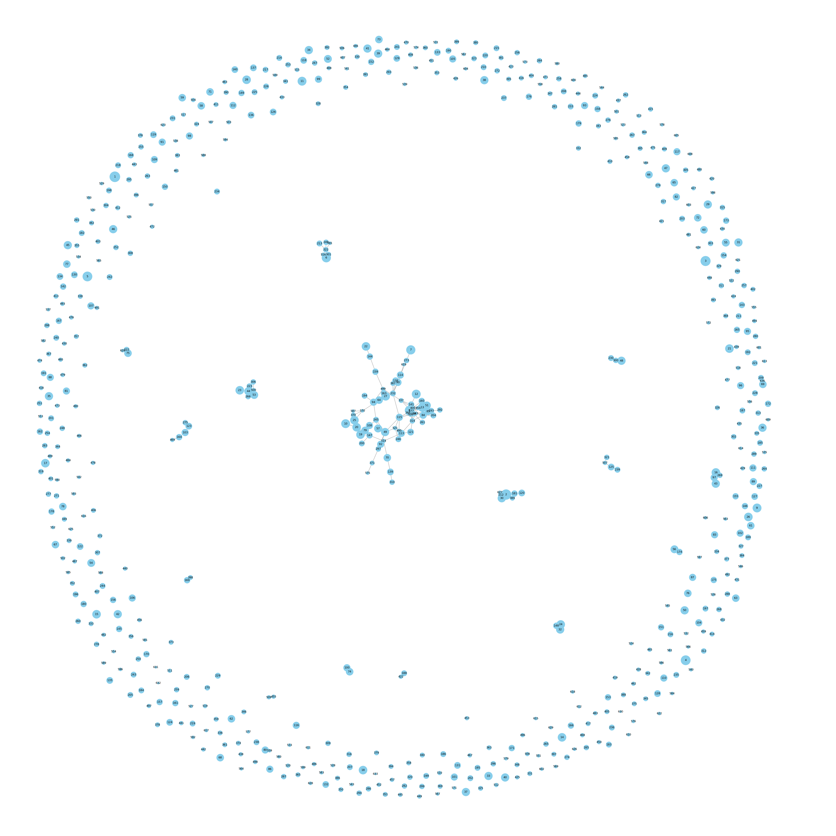
Community detection – Markov clustering
Full Data Graph
Modularity: 0.001
Conductance: 0.26
Number of Communities: 633

Slide 17
Community detection – girvan newman
Level | Modularity | Conductance
Level 7 | 0.86 | 0.002
Level 10 | 0.89 | 0.0035
Level 12 | 0.91 | 0.0038
Level 14 | 0.92 | 0.0043
Level 16 | 0.93 | 0.0047
Level 18 | 0.93 | 0.0048
Level 20 | 0.94 | 0.005

Slide 18
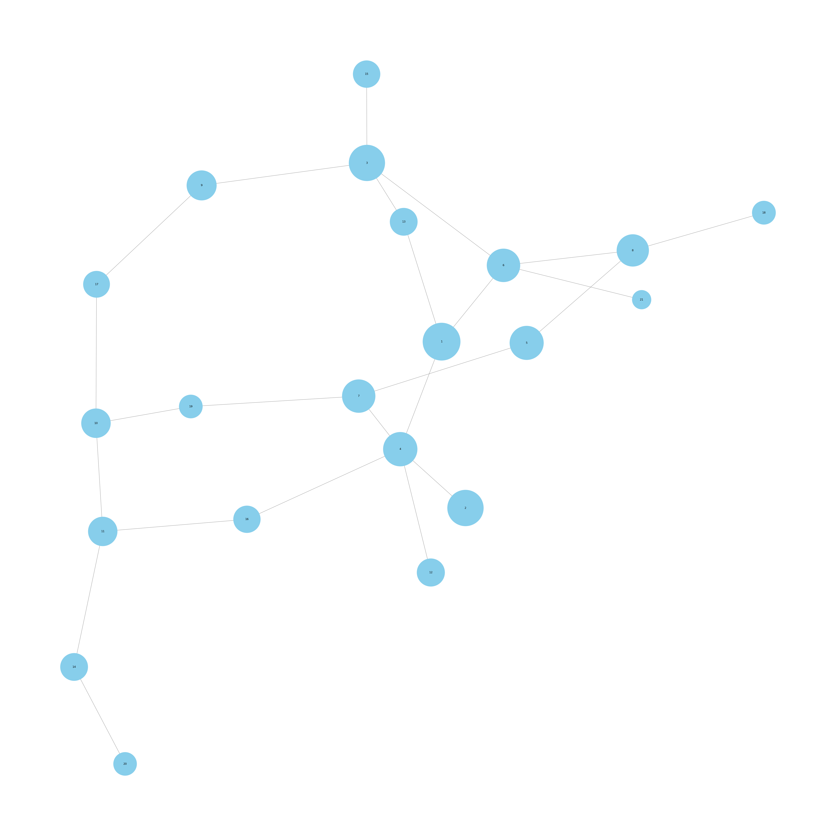
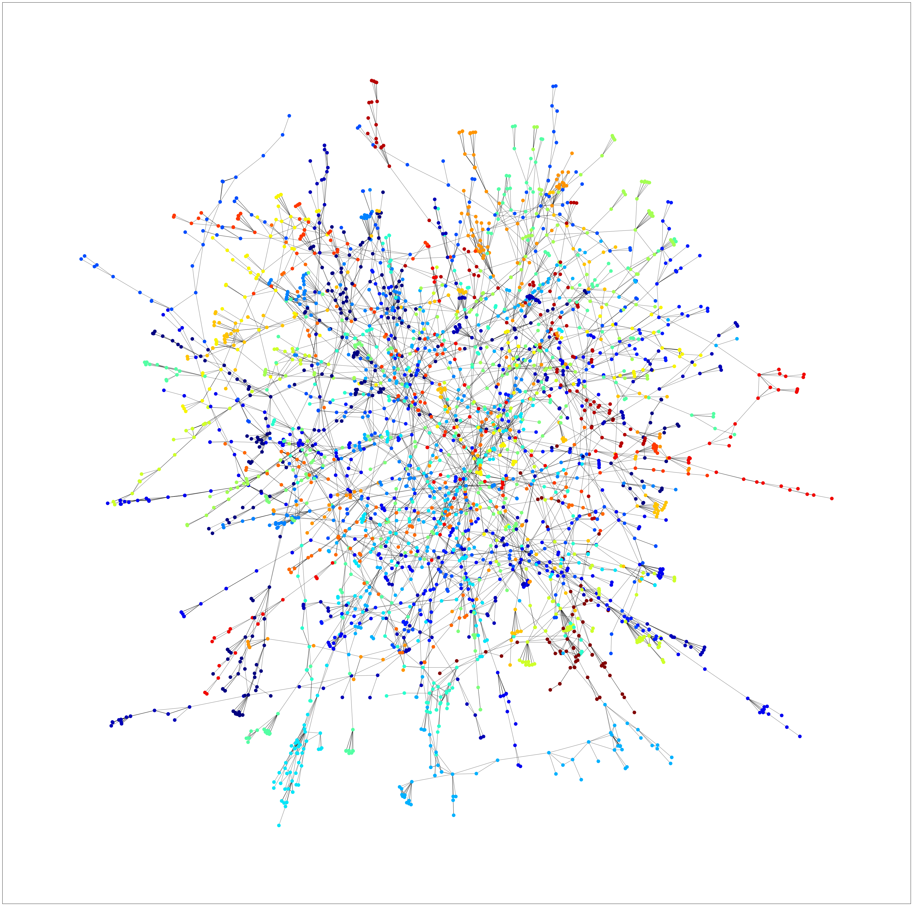
Community detection – Girvan newman (l20)
Condensed Graph
Full Data Graph
Modularity: 0.94
Conductance: 0.005
Number of Communities: 21

Slide 19
results
Best performing community detection model: Girvan-Newman Algorithm (Level 20 - 21 communities) with the modularity of 0.94 and conductance of 0.005.
Girvan-Newman was chosen the best instead of Louvain (modularity- 0.97) due to the conductance of Louvain (0.015) being higher
Worst performing community detection model: Markov Clustering Algorithm (Communities - 633) with the modularity of 0.001 and conductance of 0.26.

Slide 20
THANK YOU

